Slide 1
SUPERSTORE SALES SQL ANALYSIS
ASHISH POKHRIYAL
MANOJ UCHNEIYA
SNEHA KHANDALE

Slide 2
Problem Statement
With the constant advancement of technology and innovation, having clear cut databases and possessing departments to breathe life into interpreting them will set you in the top realm of efficiency. Execution is important but we need great inputs to yield even better outputs. There is a necessity to catch up with the growing demand and fierce competition in the market . That is why we need to leverage insights to provide more value to the customer as value is the key to everything.
Our analysis in question will be carried with Excel, SQL and finally Power BI. Excel will serve as first repository for our data, SQL will give meaning to our data and Power BI will give a clear face to our data. The following sales performance analysis will follow the 6 steps of Data Analysis which are: Ask, Prepare, Process, Analyze, Share and Act.

Slide 3
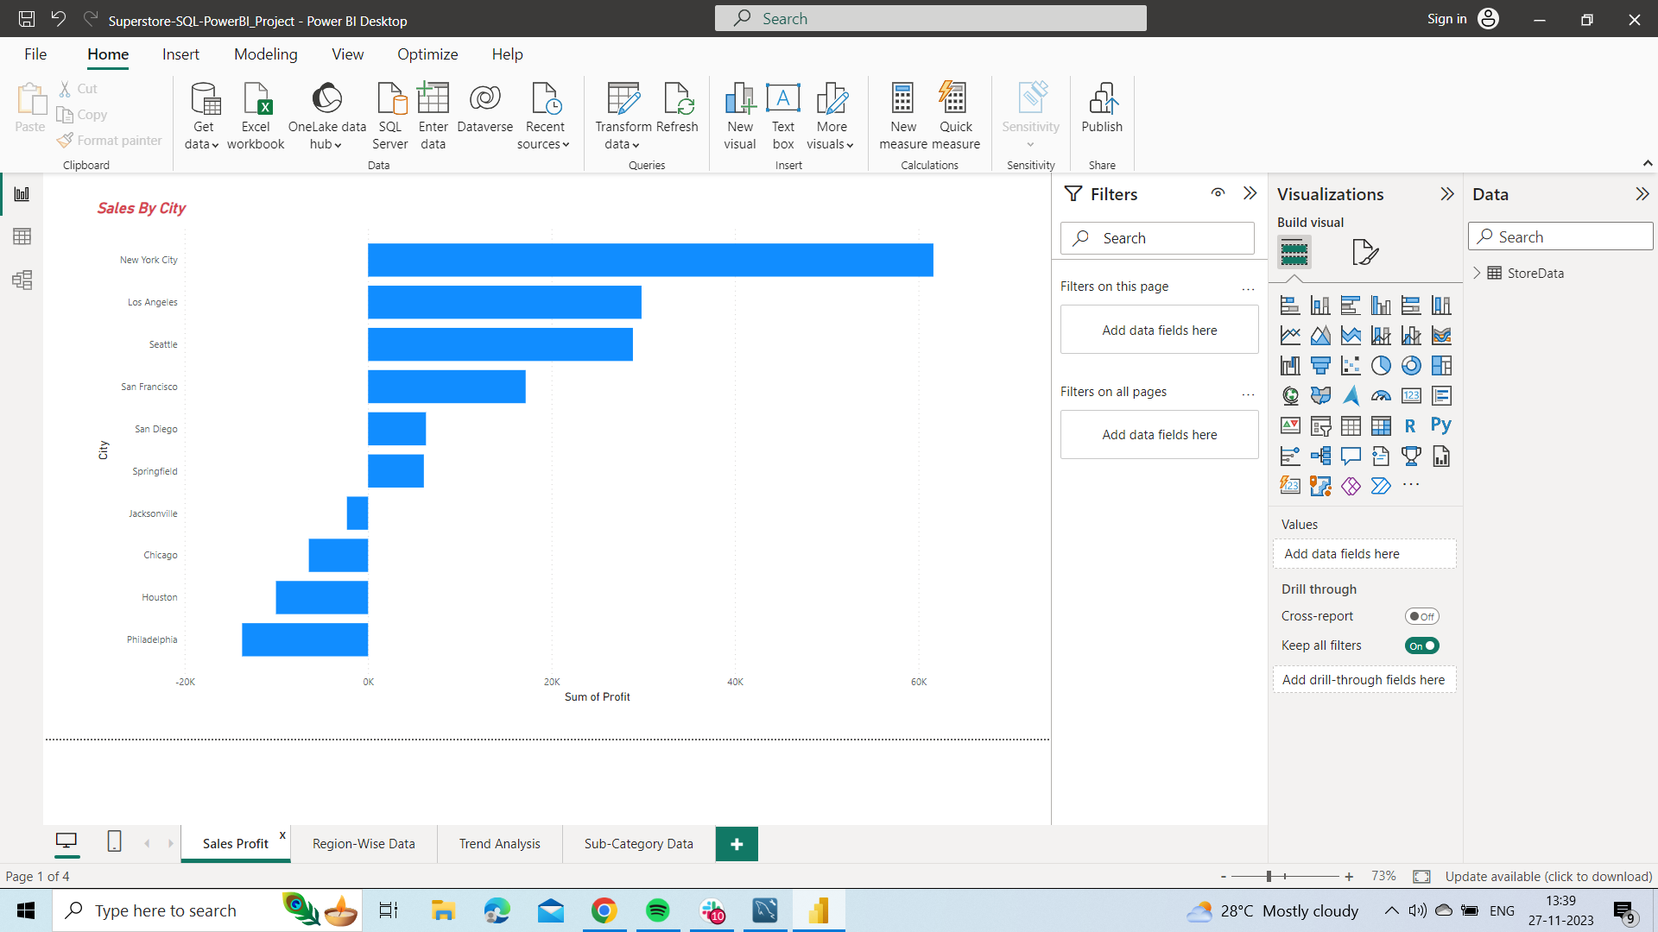
Dash - Board

Slide 4
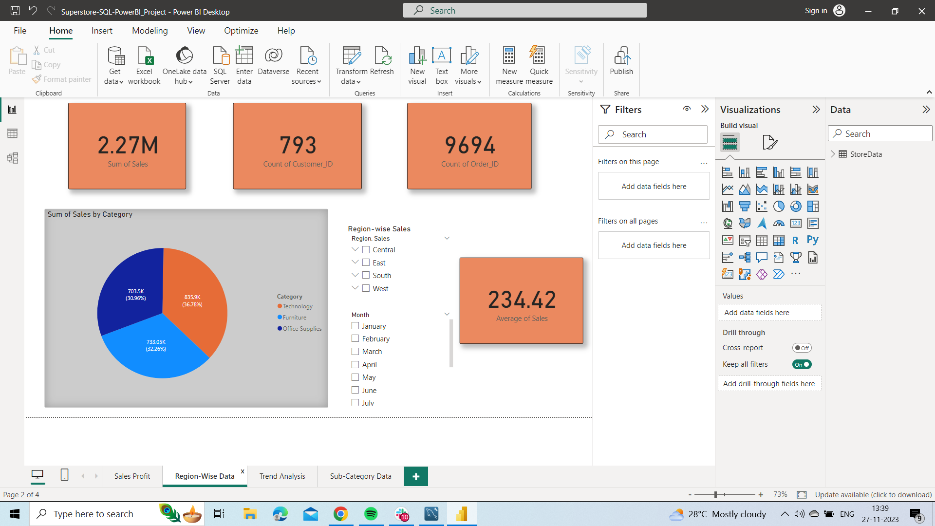

Slide 5
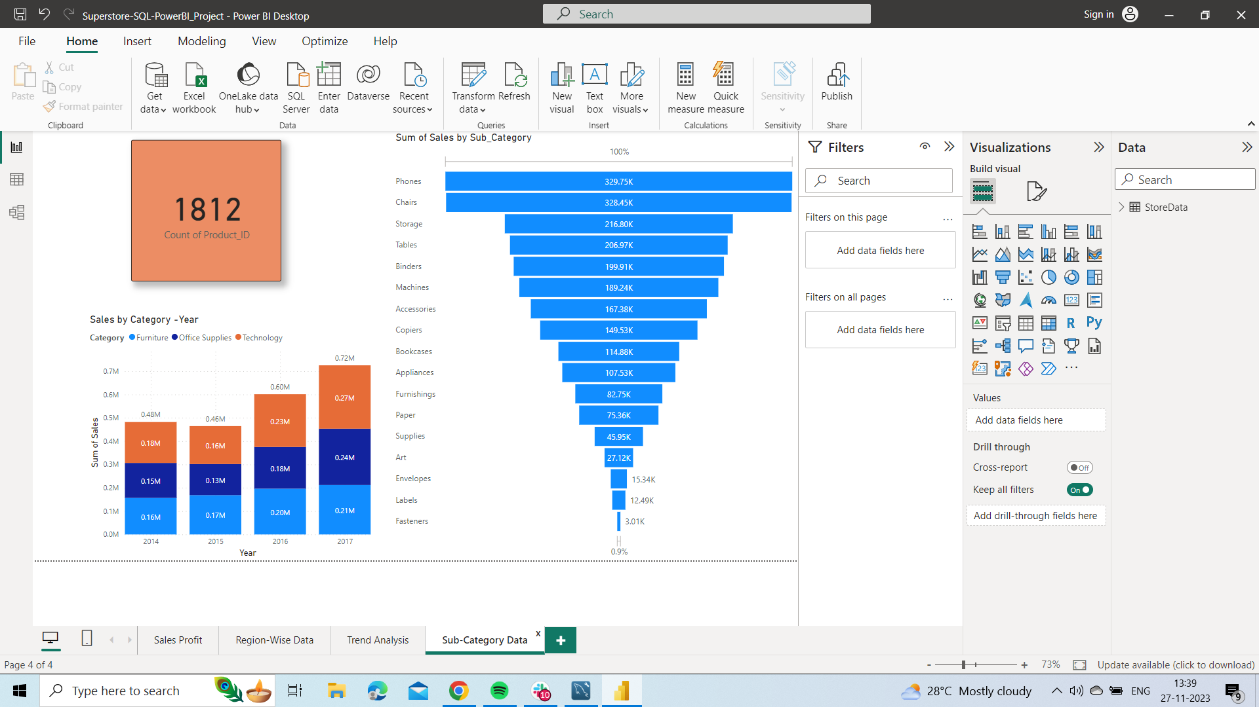

Slide 6
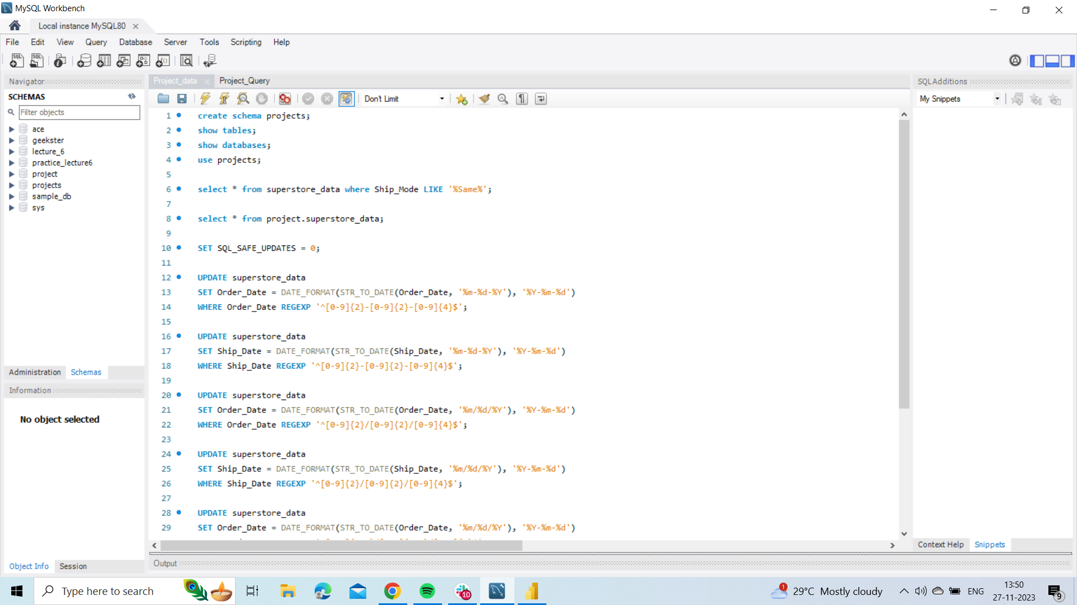

Slide 7
Project Detail Link :-
https://drive.google.com/drive/folders/1k7qpJDAD3fPEGfiKsUNd6VAJap0kudjE?usp=sharing

Slide 8
Thank You

